Slide 1

Flight Ticket Price Prediction Using ML
Presented By:
B Vijaya Lakshmi
Batch No: 460

Slide 2
About Me
I am a recent postgraduate in Data Science from Bankatlal Badruka College for Information Technology.
I have a strong interest in Data Analytics, Machine Learning, and Artificial Intelligence, and I enjoy using data-driven techniques to solve real-world business problems.
I have experience working with tools and technologies such as Python, SQL, Power BI, data analysis libraries, and data visualization tools to analyze data, build models, and generate meaningful insights.
LinkedIn: www.linkedin.com/in/bollapalli-vijaya-lakshmi
GitHub: Vijayalakshmibollapalli

Slide 3
Agenda
Introduction
Business Problem
Objective
CRISP-ML(Q)
Dataset Overview
Data Preprocessing
Model Building
Model Selection
Model Deployment
Applications
Final Business Insights and Recommendations
Conclusion

Slide 4
Introduction
Flight ticket prices change frequently depending on factors such as airline, route, travel class, number of stops, travel time, and demand. Because of these price changes, customers often find it difficult to book tickets at the right time and at affordable prices. Airlines and travel companies also face challenges in deciding the correct ticket prices.
This project aims to develop a Flight Ticket Price Prediction System using Machine Learning techniques. The system predicts ticket prices based on different flight details such as airline name, source, destination, duration, stops, and class type. Different machine learning algorithms are used and compared to identify the best model for accurate price prediction.

Slide 5
Business Problem
Airline companies and travel booking platforms face a major challenge because flight ticket prices keep changing frequently. Customers are often confused about when to book tickets, and many end up paying higher prices. At the same time, airlines may lose customers if ticket prices are too high or lose profit if prices are too low.
The main business problem is to predict flight ticket prices accurately so that:
Customers can make better booking decisions
Airlines can improve pricing strategies
Travel companies can provide better price recommendations
A smart prediction system can help both customers and businesses by providing data-driven price estimation.

Slide 6
Objective
The main objectives of this project are:
To build a machine learning model that predicts flight ticket prices accurately.
To analyze how factors such as airline, route, duration, stops, and class affect ticket prices.
To compare multiple machine learning algorithms and select the best-performing model.
To help customers identify better ticket prices before booking.
To support airlines and travel platforms in implementing intelligent pricing strategies.

Slide 7
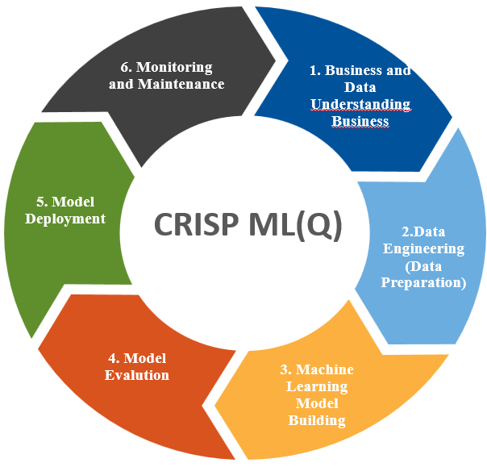
CRISP-ML(Q) Methodology
CRISP-ML(Q) is a framework used for machine learning project development.
Business and Data Understanding Identify the problem and understand the dataset.
Data Preparation
Clean and transform the data.
Modeling Learning Train the machine learning model.
Model Evaluation
Test the model performance.
Model Deployment
Implement the model in a real system.
Monitoring & Maintenance
Continuously check and improve the model.

Slide 8
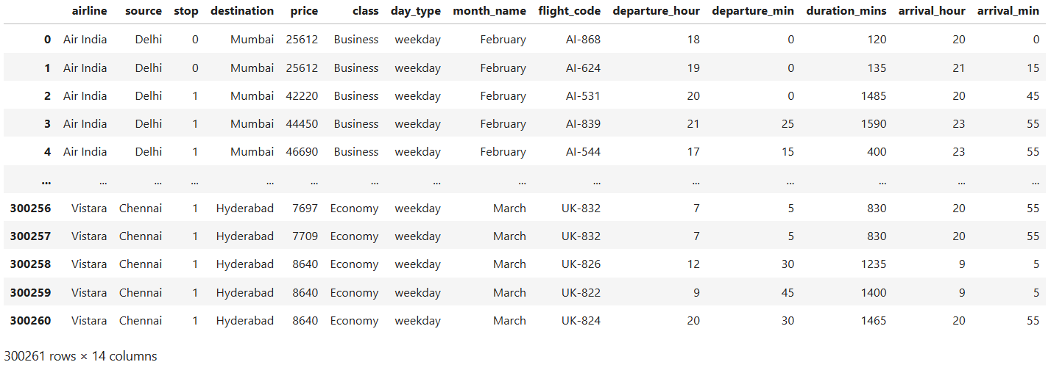
1. Data Set Overview
Flight Information Features : airline, ch_code, num_code, flight_code
Route / Travel Features: source, destination, stop, class
Time-Based Features: date, month_name, day_type, dep_time, departure_hour, departure_min, arr_time, arrival_hour, arrival_min
Duration Features: time_taken, duration_mins
Target Variable: price
Dataset Size
Business Dataset Records: 93,487
Economy Dataset Records: 206,774
Total Combined Records: 300,261
Total Columns: 11

Slide 9
2. DATA Preprocessing
Data Cleaning & Preparation
Combined Economy and Business datasets into a single dataset
Added a new column: class
Removed unnecessary columns: date, dep_time, arr_time, ch_code, num_code, time_taken
Separated: Features (X) and Target (y)
Feature Engineering
Created: day_type (weekday/weekend), month_name, flight_code
Extracted:
departure hour and minute
arrival hour and minute
Converted journey duration into: duration_mins
Converted: stop into numerical format
Renamed: from → source, to → destination
Encode Categorical Variables
One Hot Encoding (Nominal Columns): airline, source, destination, day_type, month_name
Ordinal Encoding (Ordered Columns): class → ['Economy', 'Business']

Slide 10
Feature Scaling & Transformation
Standardization (Scaling): Applied to all numerical features using StandardScaler (Mean=0, Standard Deviation=1)
Power Transformation: Applied Yeo-Johnson transformation to normalize numerical data
Pipeline & Column Transformer
Created separate pipelines for:
Numerical features
Nominal features
Ordinal features
Combined all preprocessing steps using:
ColumnTransformer
Pipeline
Train-Test Split
Split dataset into:
80% Training Data
20% Testing Data

Slide 11
3. Model Building
The problem is treated as a Regression task since the target variable is price, which is continuous.
Multiple Machine Learning models were trained and compared to identify the best-performing algorithm:
Linear Regression
K-Nearest Neighbors (KNN) Regressor
Decision Tree Regressor
Random Forest Regressor
Gadient Boost Regressor
XG Boost Regressor
Each model was trained using a pipeline (preprocessing + algorithm).

Slide 12
4. Model Selection
Comparing models using Evolution metrics:
Error metrics: RMSE, MSE.
Goodness of fit: R² score.
Choosed the model with lowest error and highest R².
Model | RMSE | R² Score
Linear Regression | 6857 | 0.908
KNN Regressor | 4019 | 0.968
Decision Tree Regressor | 3148 | 0.980
Random Forest | 3055 | 0.981
Gradient Boosting | 5112 | 0.949
XGBoost Regressor | 3335 | 0.978
XG Boost Regress is the best Model

Slide 13
Cross validation
Method Used: K-Fold Cross Validation
Model : XG Boost
Dataset split into 5 equal folds
Evaluation Metric: R2 Score
Hyperparameter Tuning
Method Used: Grid Search
Tested multiple combinations of:
n_estimators → [200, 300]
learning_rate → [0.05, 0.1]
max_depth → [5, 7]
Best Parameters Found
Learning Rate = 0.1
Max Depth = 7
Number of Estimators = 300
Improved R2 Score = 0.978

Slide 14
5. Model Deployment
For deployment Streamlit used
Build a simple UI where users can input data and get predictions.
Pushing Streamlit app to Hugging Face Spaces for free hosting
Hugging Face:- Flight Ticket Price Prediction - a Hugging Face Space by Vijayalakshmibollapalli

Slide 15
Applications
Used in flight booking platforms like MakeMyTrip and Goibibo
Helps customers find cheaper flight tickets and choose the best booking time
Supports airline dynamic pricing and revenue management systems
Predicts future flight ticket prices using historical data
Used in smart travel recommendation and fare comparison systems
Analyzes travel demand, pricing trends, and customer booking patterns

Slide 16
Challenges Faced
Handling a large dataset with more than 300,000 flight records.
Converting time-related features such as departure time, arrival time, and duration into usable numerical format.
Cleaning inconsistent values in the stop column and duration column.
Preventing overfitting in tree-based models such as Decision Tree and Random Forest.
Selecting the best-performing model among multiple regression algorithms.
Performing hyperparameter tuning to improve model accuracy and generalization.
Handling high variation in ticket prices between Economy and Business class flights.

Slide 17
Final Business Insights and Recommendations
Key insights:
Business class tickets are significantly more expensive than Economy class tickets.
Flight duration has a major impact on ticket prices; longer journeys usually cost more.
Ticket prices vary based on airline, route, and number of stops.
Weekend and seasonal travel demand can increase ticket prices.
Direct flights generally have higher prices compared to connecting flights.
Recommendation:
Airlines can use dynamic pricing strategies based on demand and travel patterns.
Customers should book tickets early to get lower prices.
Travel platforms can provide smart price prediction and booking suggestions.
Real-time data integration can improve prediction accuracy and customer experience.

Slide 18
Conclusion
Successfully addressed the airline industry's major challenge of flight ticket price prediction by developing an accurate and scalable Machine Learning solution using a dataset of more than 300,000 flight records..
The model effectively captures the impact of important factors such as travel class, airline, route, duration, number of stops, and travel timing, enabling more accurate flight fare prediction.
Multiple Machine Learning models were implemented and compared. Among all models, XGBoost achieved the best performance with: R² Score = 0.981, RMSE = 3119, Cross Validation Score = 0.9812
Business Impact:
Helps customers find better ticket prices
Supports airlines in implementing smart pricing strategies
Improves customer booking experience
Assists travel platforms with price forecasting and recommendations
Enables data-driven decision making in the travel industry
Final Outcome:
A production-ready and deployable Flight Ticket Price Prediction System was successfully developed and can be integrated with platforms like Streamlit and FastAPI for real-time fare prediction.

Slide 19

THANK YOU

